Slide 1
Proof of Concept/
Synthesis & Evaluation
Analysis and Build
Student Name: Kobe Salyers
Subsystem: Vision System
Team Name: ChronoCats

Slide 2
Synthesis – Create your Design
Instructions (Mechanical builds)
Synthesis – Create your Design
Now you know what your design should be like and the constraints you have in constructing it. All team roles contain a mechanical build component. Create a 3D solid model (OnShape or equivalent) of that design which you can use for making your initial prototype. If you are starting with a laser cut box, you can use MakerCase and Adobe Illustrator to make your design. The design should be to ready to fabricate.
Paste an image/screenshot of your design (OnShape or Adobe Illustrator) into the slide below as indicated. Include the following information on a separate slide:
List of the materials you will need
Identify the most difficult area to build or get functioning (anticipated)
Make a time estimate for going from this design to a built prototype. This means a LIST of key tasks and the TIME needed to perform each task (use days to complete with the understanding that you will be also doing other things on those days so you will only get a small amount of time each day to work on this).

Slide 3
Synthesis – Create your Design
Mechanical Builds
Synthesis – Create your Design
All roles have a mechanical build. We are looking for a solid model or CAD layout in Adobe Illustrator for the following:
Vison System- create a first pass of your dice roller
GUI – create a first pass of your device that shows who’s turn it is with LEDs lighting under the player’s number
Game Piece mover- You have already created a 3D solid for you game piece. Now create a solid for the end effector that will grab your game piece.
Game Board design- Create your dump position.
Game Structure- The design for the tower that will hold the game piece mover subassembly.

Slide 4
Synthesis – Create your Design
Rubric
Synthesis – Create your Design
RUBRIC:
Solid model - 6 points
List of materials OR list of inputs and outputs, and how - 2 points
Most difficult area - 2 points
Time estimate - 2 points

Slide 5
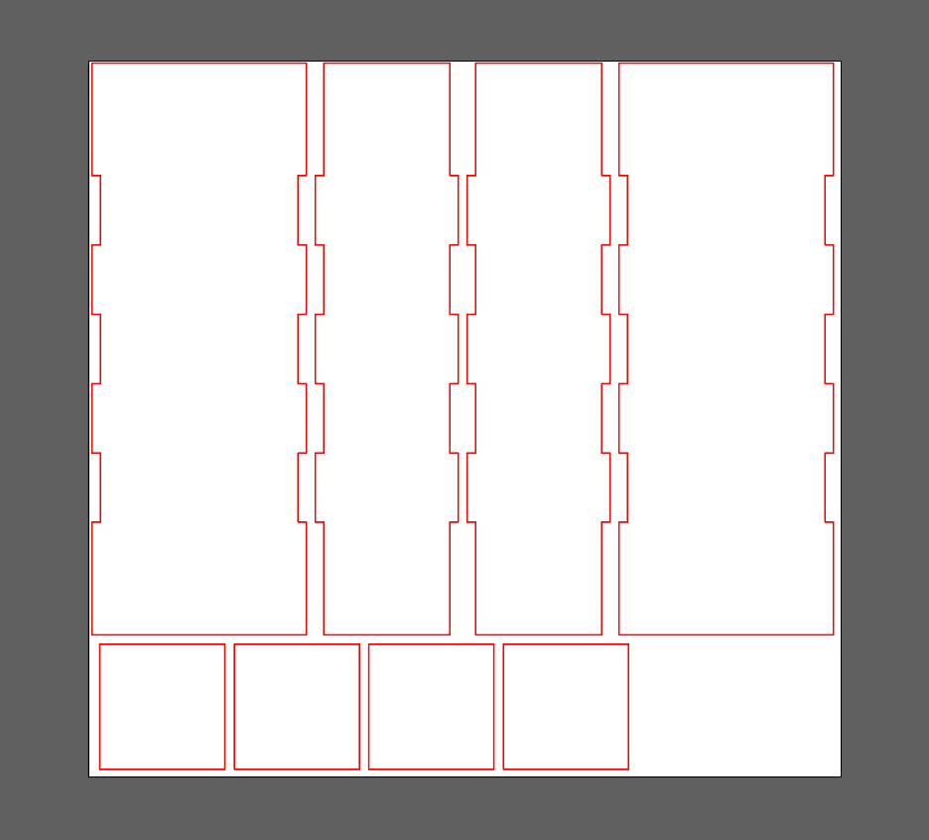
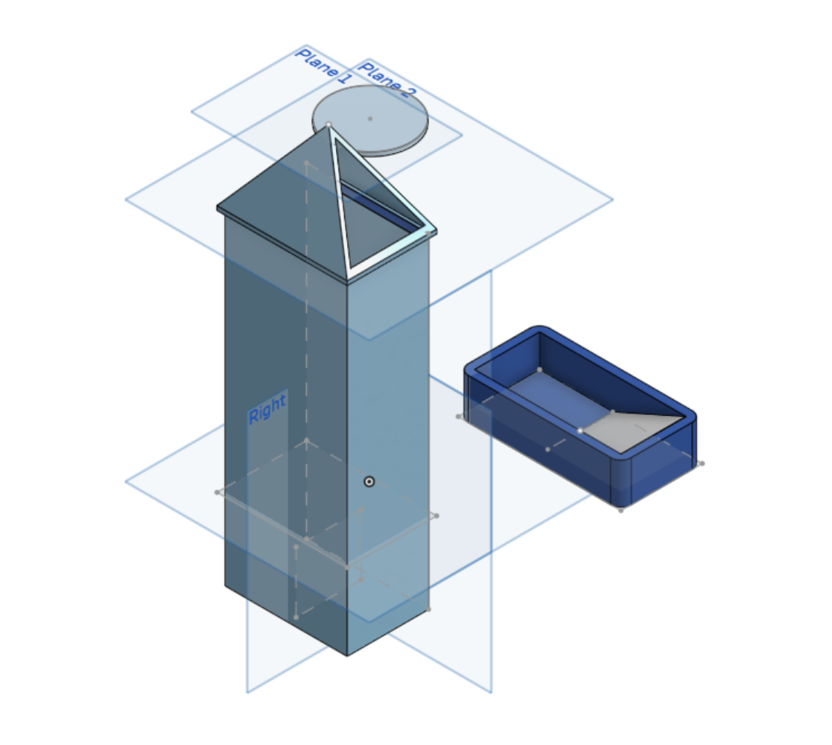
Synthesis – Create your Design Image goes here
Synthesis – Create your Design
Adobe Illustrator model of main tower Onshape model of complete tower
with roof, clock face, and dice tray.

Slide 6
Synthesis – Create your Design – answer questions here
Synthesis – Create your Design
List of materials OR list of inputs and outputs, and how - 2 points
Most difficult area - 2 points
Time estimate - 2 points
Materials:
2, 3 x 8 x 1/8 inch plywood walls.
2, 2 x 8 x 1/8 inch plywood walls.
4, 2 x 2 x 1/8 inch plywood ramps.
3d printed roof.
3d printed dice tray.
3d printed clock face.
Plastic ramp, Camera, dice.
Most difficult area:
The hardest part when creating the build has been seating the ramps into the tower. The easiest way I found to do this was to leave one wall off of the tower and slide them into place with glue.
Time Estimate:
Waiting for laser cutting: 2 hours
Total 3D print time: 3 hours
Construction/drying: 7 hours

Slide 7
Prototype
Instructions
Now it is time to move from paper and thought to actually building or creating. You have a Build Demonstration instruction in your assignment. This build is unique to your role and should start you on the path of a working prototype. As you do this you are likely to have one or more of the following experiences:
You discover that there are parts of the design that you didn’t consider, and you will need to modify your design.
Certain parts may not move/behave/look the way you envisioned. You may need to troubleshoot the problem and make a correction to your design.
The materials or methods you selected to create your subsection turn out not to be appropriate for the task.
You need to consider how your subsection is going to interface with others and spend time working with those team members.
All of these are common to the prototype process. Be willing to work with and help teammates so that your team has a better overall design.
Include an image of your Build Demonstration : These points are credit for fabrication of parts and initial integration. These points are not for a working system. Those points are awarded for the video link as described on a future slide.
A rubric can be found on the next slide.
Prototype

Slide 8
Prototype
Rubric
RUBRIC
An image showing a prototype (either physical build or code/build) – 4 points
Vision: Dice roller with dice in bottom tray and camera overhead
Game Structure: Assembled game board and stepper motor and any support/gearing needed for motion.
Game Piece Mover: Single game piece and assembled end effector that look like they could link together.
Game Board: An assembled swap station, and an assembled dump station. These can be two images.
GUI /Controlling code: The assembled test structure described in the Build Demonstration Arduino and components, code loaded into MATLAB in separate screenshot.
Quality and effort of prototype – 4 points
Prototype

Slide 9
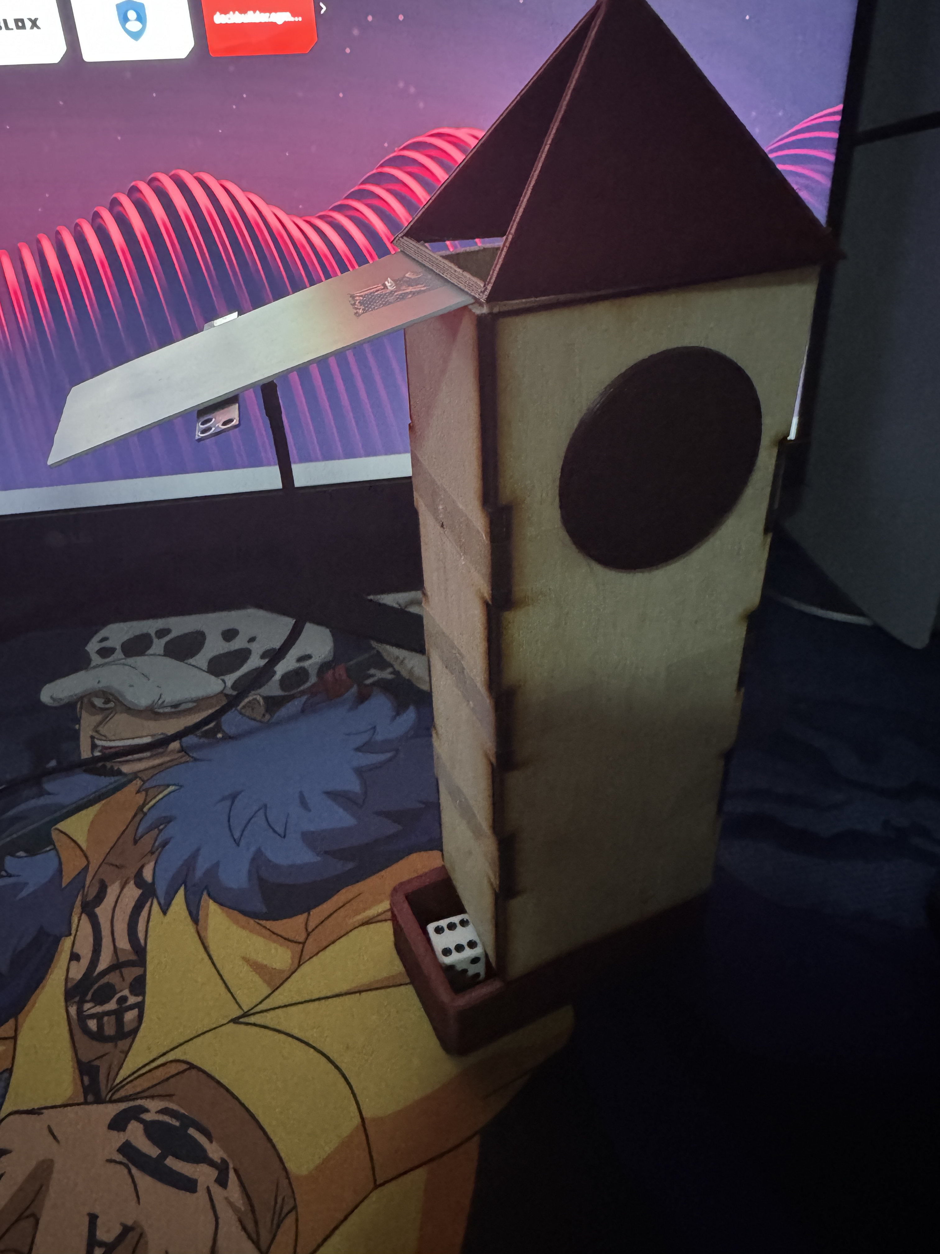
Prototype Image(s)
Prototype

Slide 10
Evaluation – Proof of Concept
Instructions
Evaluation – Proof of Concept
The last step is to develop a "test" to prove that your design concept should work. On Canvas you will find the link to a Build Demonstration to perform for your subsystem. That demonstration is the “proof of concept” for your design. Since this is a demonstration of function, the output of this demonstration will be captured on VIDEO.
In the assignment is a link for instructions on how to upload a video to Yuja, which is UK’s free cloud storage and is linked to Canvas. You can also use You Tube if you feel more comfortable with that.
You can find a rubric for this section on the next slide.

Slide 11
Evaluation – Proof of Concept
Rubric
Evaluation – Proof of Concept
For each of the following: 15 points for function demonstrated, 10 points if it mostly works, and 5 points if it was a good attempt.
Game Structure: URL to video showing stepper motor moving platform 360° and back again.
Vision System: URL or video showing MATLAB getting an image from a dice in the dice tray, processing the image and returning a black background image with white blobs for dots on the dice. While taking video be sure to end with the Table Of Properties showing the right number of rows, or showing a “height” variable with the right number.
Game Board: URL or video showing a working swap station and then a working dump station, or two videos with one in each.
Game Piece Mover: URL of video of a prototype showing end effector grabbing and lifting game piece and then releasing it in a controlled fashion.
Code: URL of video of code and Arduino performing the tasks called out in the Flowchart.

Slide 12
Evaluation – Proof of Concept Embed video or link here
Evaluation – Proof of Concept
NOTE This needs to be a LINK to a VIDEO or a comment that you have done an additional entry and to submit your file with Yuja. You can put a Yuja link here, or create a separate upload to directly embed the video using Yuja.
The LINK to my video is:
https://youtube.com/shorts/Emdr6WnCWw4?si=UJrkMTWYabplTAd5
POC Model 3 Test

